Slide 1
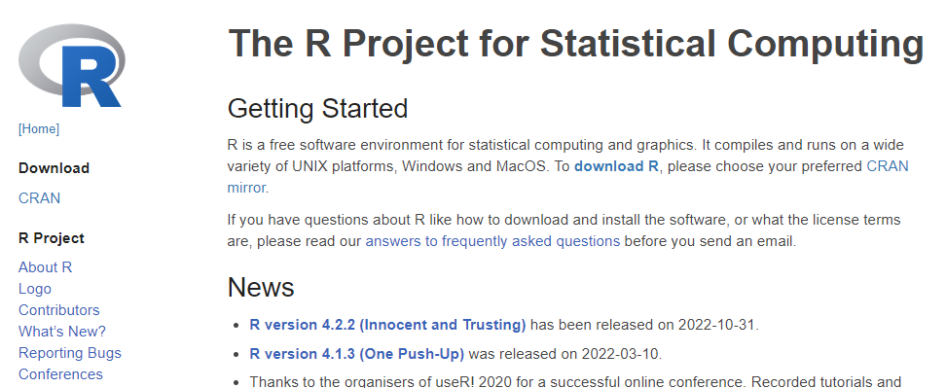
1. Click “download R”
Note: new versions are released a few times a year

Slide 2
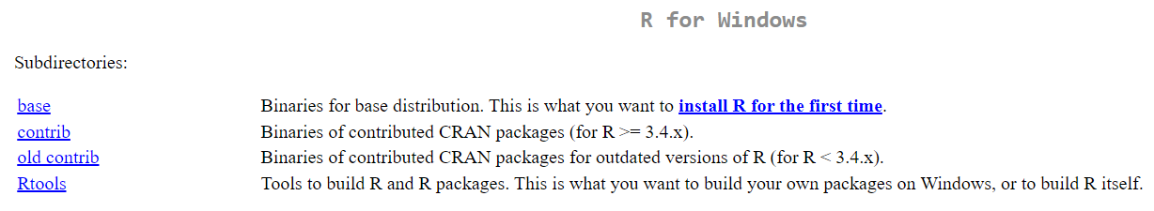
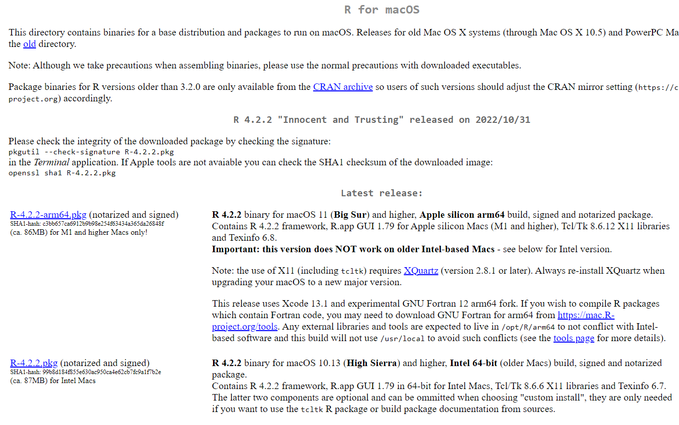
Depends on your operating system

Slide 3
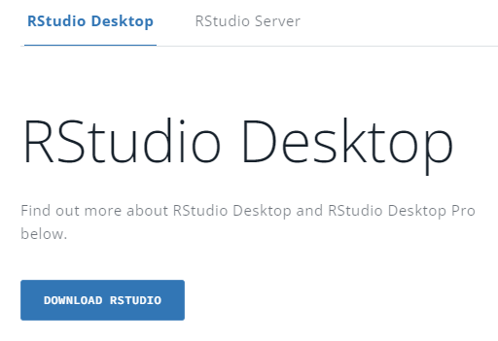
1. Click button
2. Click button

Slide 4
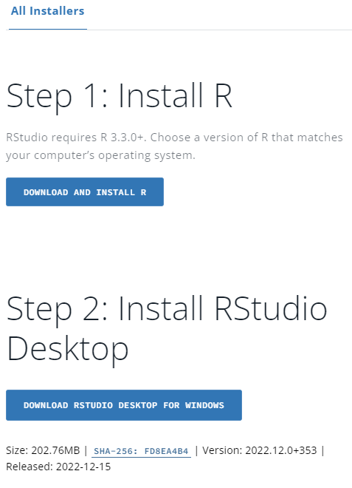
We already did this
Automatically know which computer type you have
3. Click button

